Slide 1
损失景观的嵌入原则
许志钦
2023年11月9日 Thursday

Slide 2
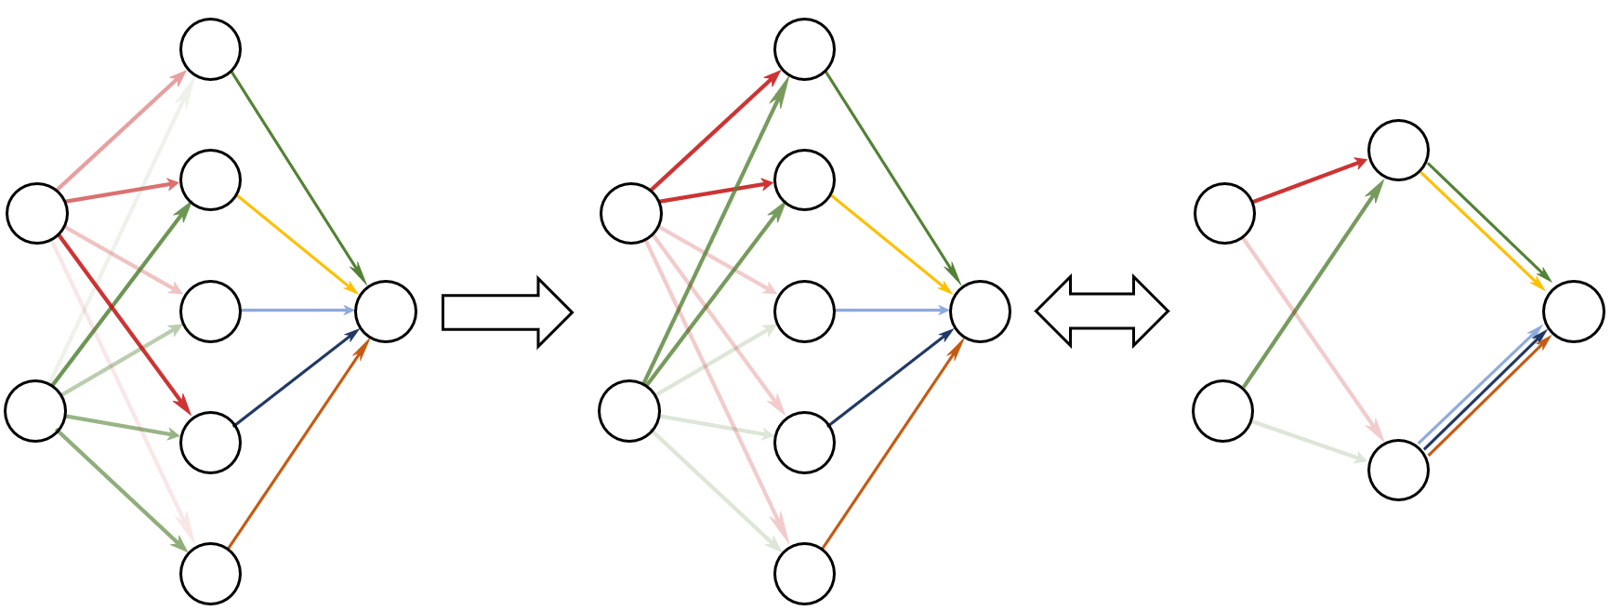
Condensation
Initial: Neurons different
After training: Clustered
Effective small net
Condense
Embedding
Luo#, Xu#, Ma, Zhang*, JMLR, 2021

Slide 3
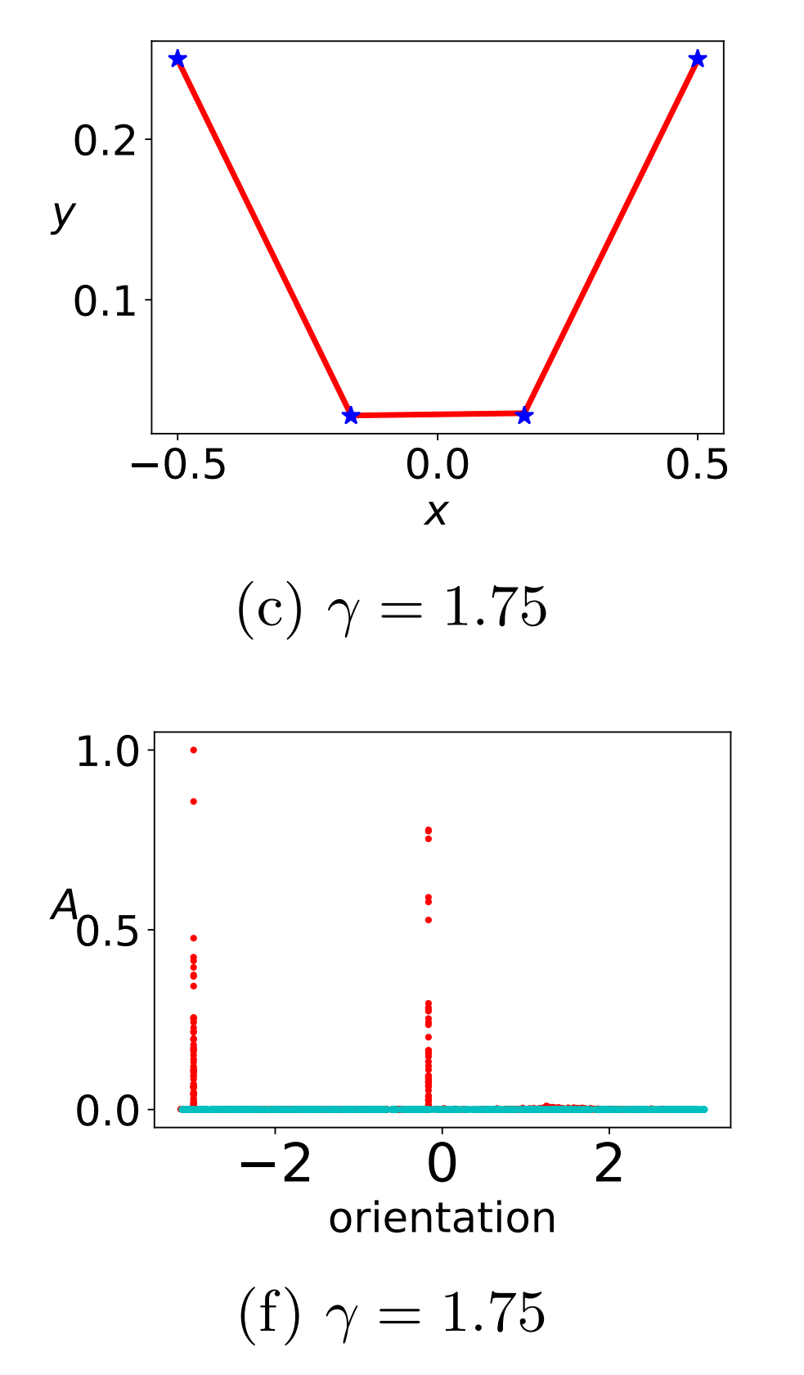
Few effective neurons
Two ReLU neurons are enough!
Tao Luo#, Zhi-Qin John Xu #, Zheng Ma, Yaoyu Zhang*,
Phase diagram for two-layer ReLU neural networks at infinite-width limit, Journal of Machine Learning Research (2021)

Slide 4
Few effective neurons
The original large network
Similar?
Two ReLU neurons network!
Why do not just train small network???
[6] Luo#, Xu#, Ma, Zhang*, 2007.07497, JMLR

Slide 5
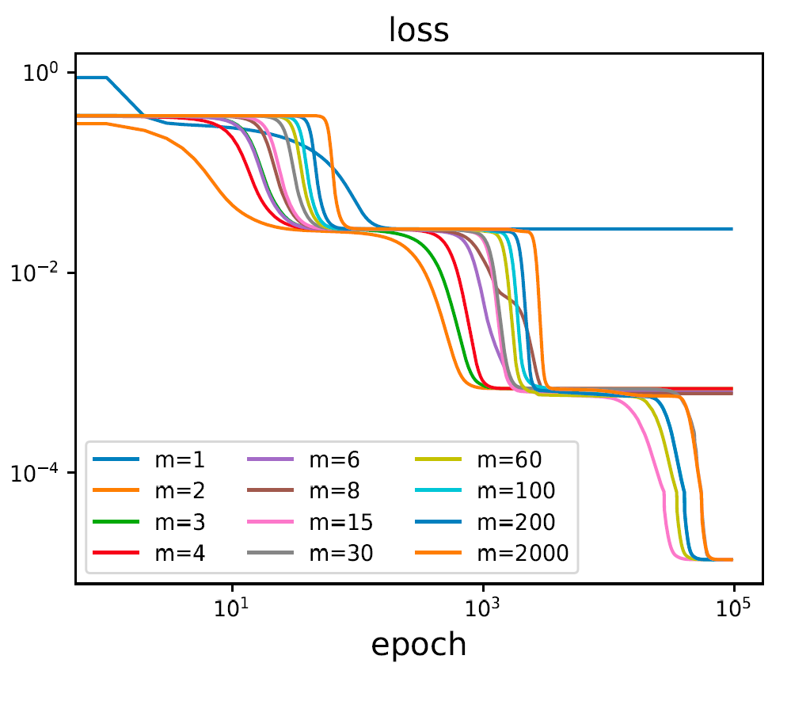
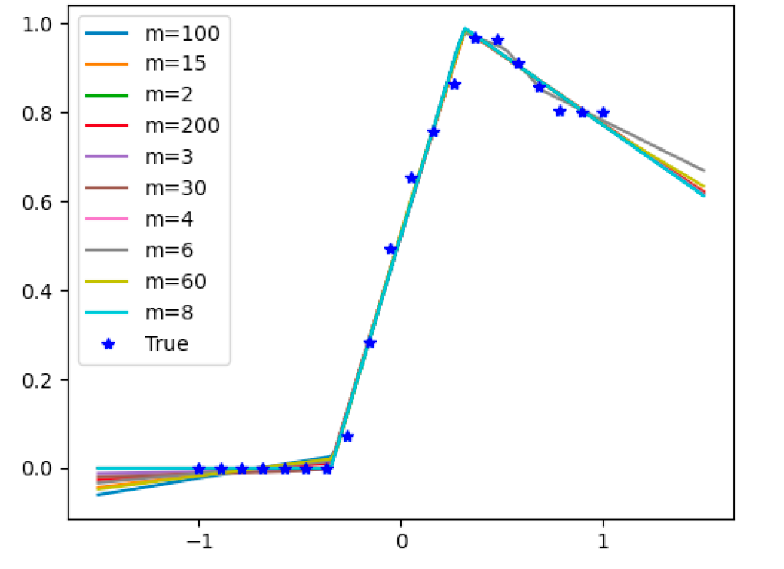
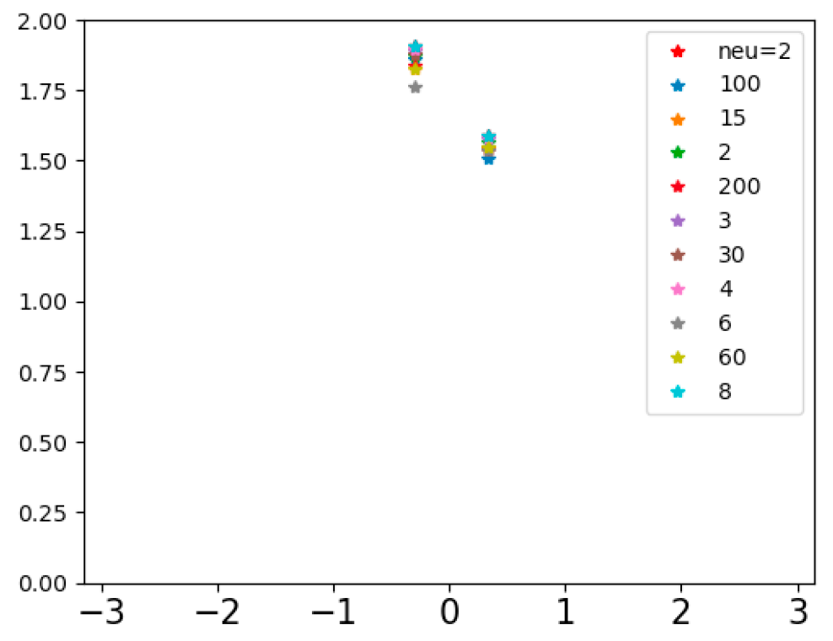
NN of diff width go through same point
1 similar saddles
2 same loss
3 same output
4 similar condense
Zhang*, Zhang, Luo, Xu*, NeurIPS (spotlight), 2021

Slide 6
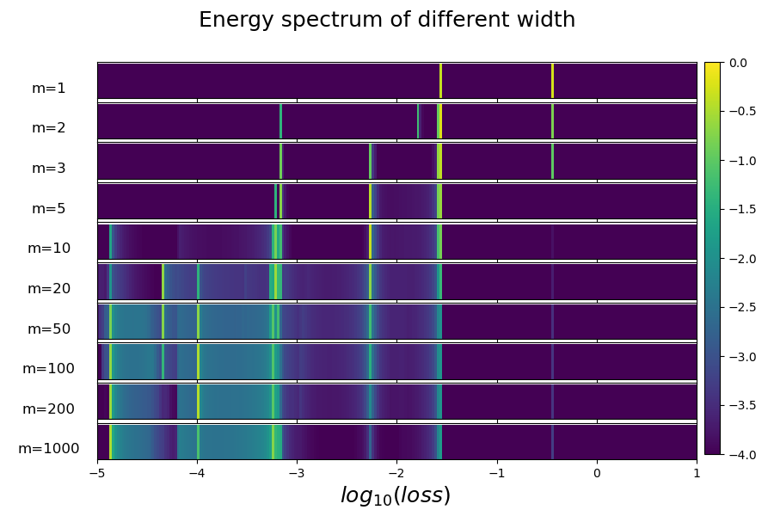
Loss spectrum: distribution over multi-trials
For a net with m neurons,
Train from different initialization with same distribution multiple trials
Count the frequency of all loss values in a small interval
Color: frequency
Stagnation
Zhang*, Zhang, Luo, Xu*, NeurIPS (spotlight), 2021

Slide 7
Loss spectrum: distribution over multi-trials
Larger net,
Easier to decay
Zhang*, Zhang, Luo, Xu*, NeurIPS (spotlight), 2021

Slide 8
Study similarity and difference of different widths from Loss Landscape

Slide 9
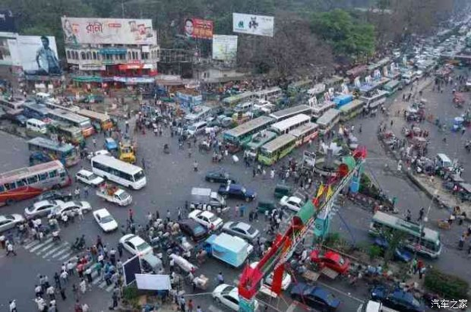
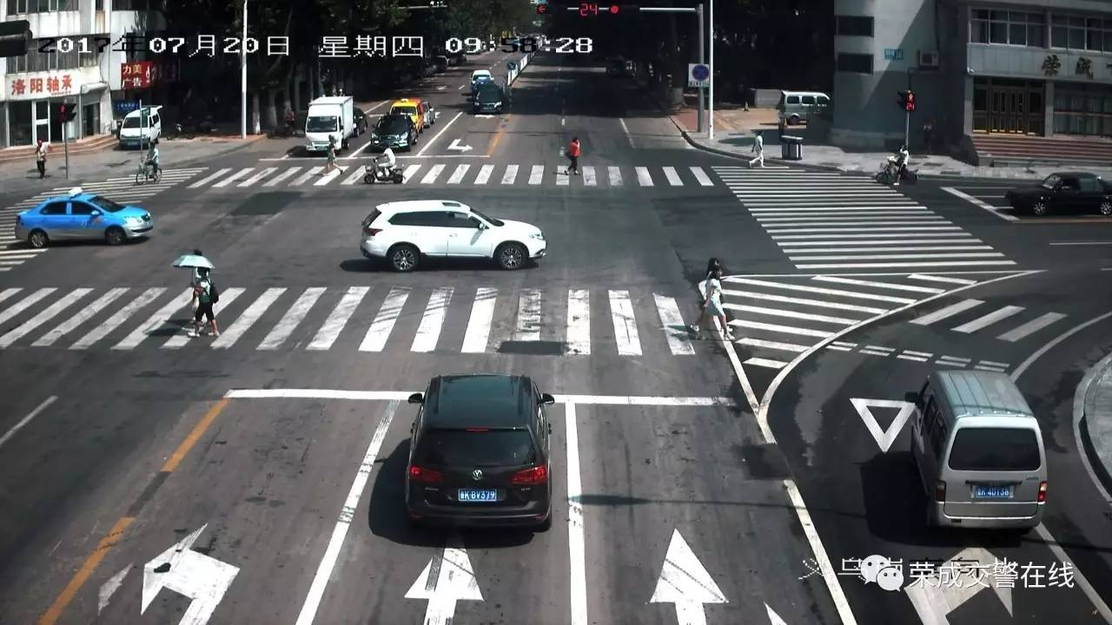
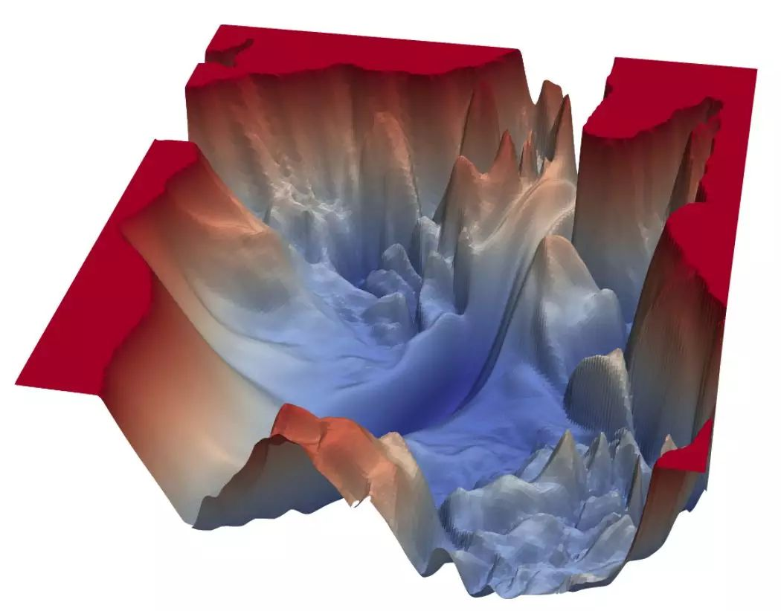

How to survive in such complex configurations
Li et al., arXiv:1712.09913

Slide 10
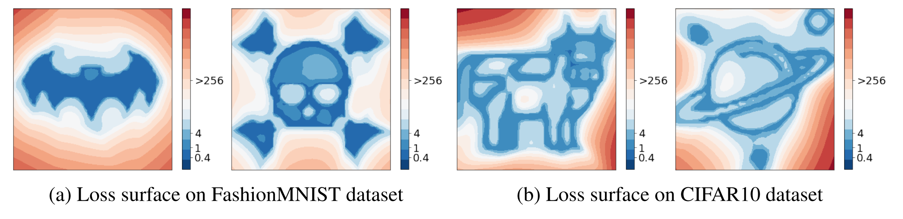
Loss landscape can be any pattern
I. Skorokhodov, M. Burtsev, 2019

Slide 11
Who can be a traffic policeman in training?

Slide 12
Saddle point
Characteristics:
1, attract the trajectory
2, slow down the training

Slide 13
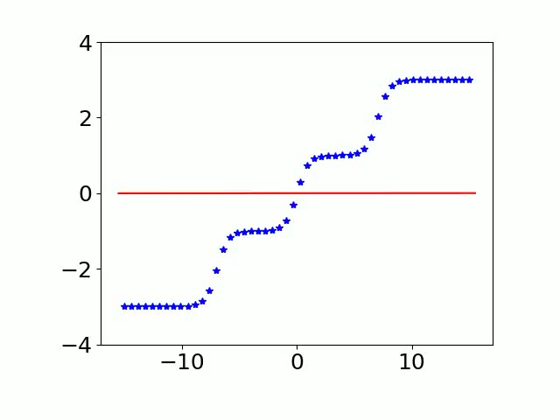
Another viewpoint for training process
500 tanh neurons
Single-neuron net optimum
Three-neuron net optimum
[16] Zhang*, Zhang, Luo, Xu*, NeurIPS (spotlight), 2021

Slide 14
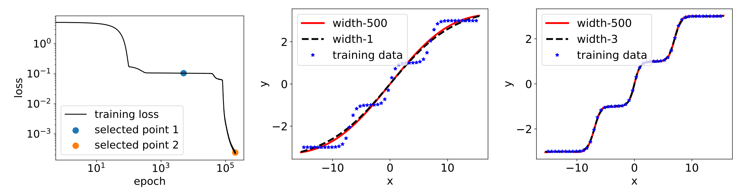
Critical points
Critical points:
1. Related to output, in some sense, can be defined by output but not parameters.
2. Critical points of wide NN should contain/see critical points of narrow NN
[16] Zhang*, Zhang, Luo, Xu*, NeurIPS (spotlight), 2021

Slide 15
Conjecture
training goes from small-net optimum to large-net optimum
Initial
Theoretical basis: optimum function of small net is a critical function of large network
1-neu net optimum
3-neu net
optimum
…

Slide 16
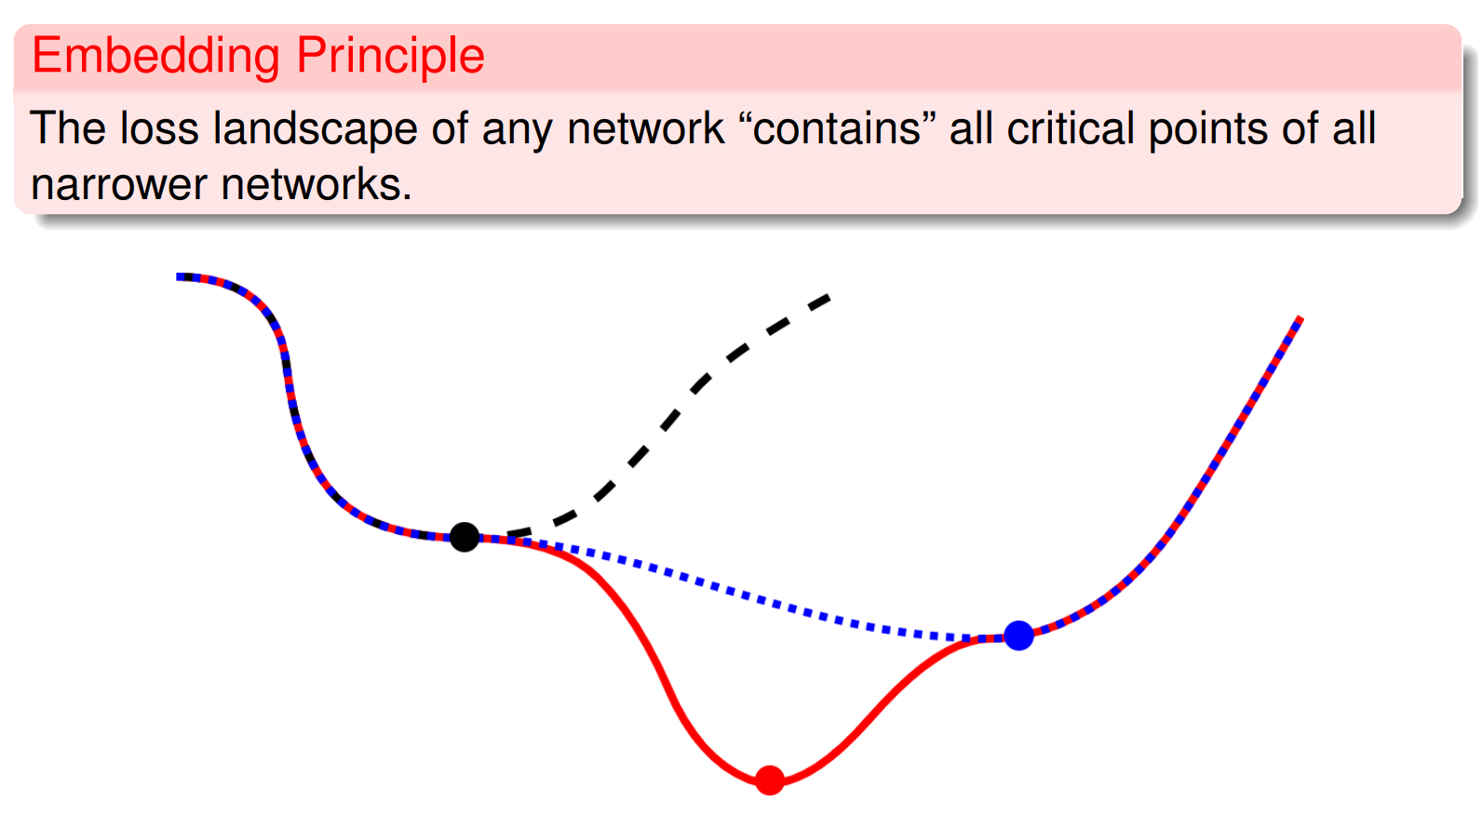
[16] Zhang*, Zhang, Luo, Xu*, NeurIPS, 2021

Slide 17
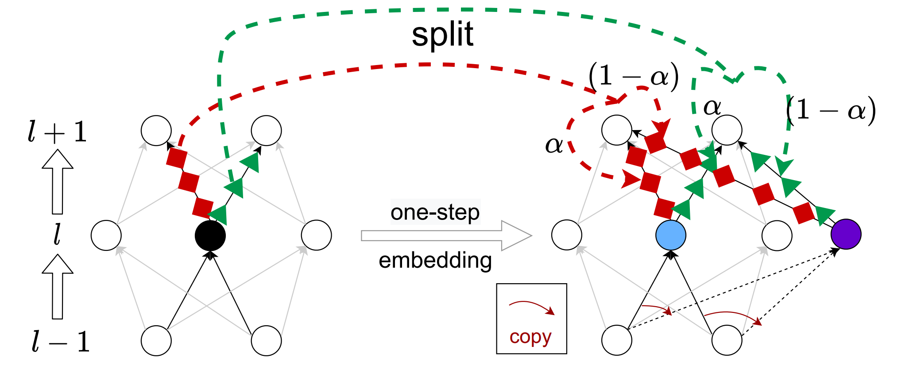
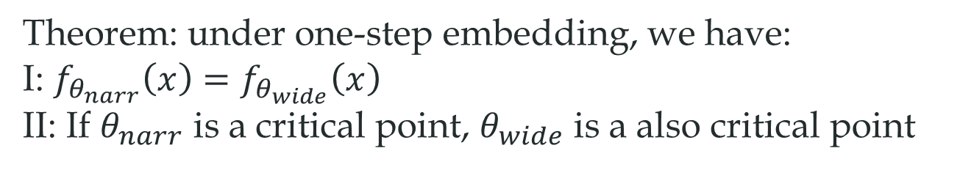
Embedding principle
the loss landscape of any network “contains” all critical points of all narrower networks.
Theorem: under one-step embedding, we have:
I: $f_{θ_{narr}}\left(x\right)=f_{θ_{wide}}\left(x\right)$
II: If $θ_{narr}$ is a critical point, $θ_{wide}$ is a also critical point
Condensation
[16] Zhang*, Zhang, Luo, Xu*, NeurIPS , 2021

Slide 18
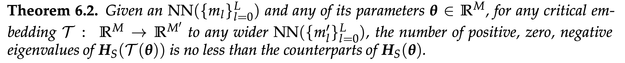
Properties
Larger network, larger degeneracy
Larger network, almost more descent directions
Zhang*, Li, Zhang, Luo, Xu*, Journal of Machine Learning, 2022, Zhang*, Zhang, Luo, Xu*, NeurIPS (spotlight), 2021

Slide 19
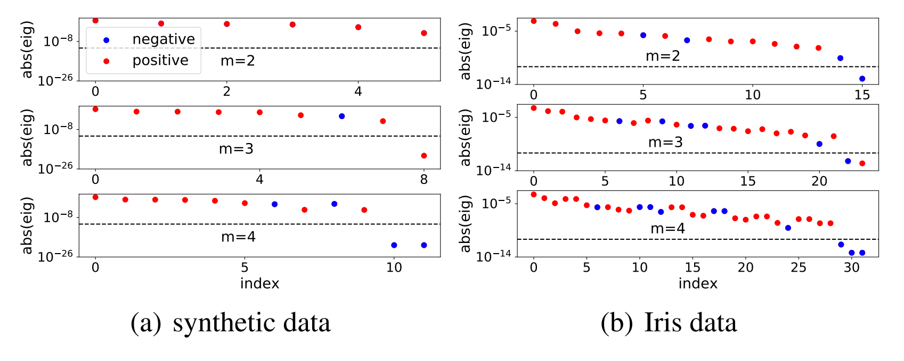
Degeneracy
Comments: maybe why wider is easier for training:
not local minima, more descent directions
Zhang*, Zhang, Luo, Xu*, NeurIPS (spotlight), 2021

Slide 20


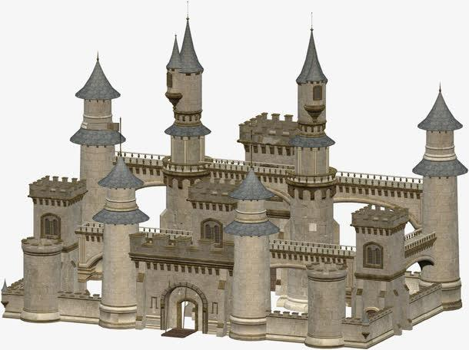
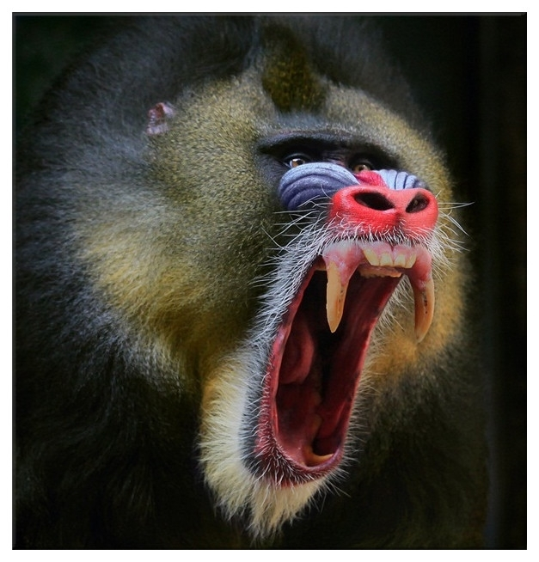


An intuitive conjecture: guided by smaller NNs’ critical points
3-neu’s critical point
6-neu’s critical point
2-neu’s critical point
4-neu’s critical point
1-neu’s critical point
5-neu’s critical point
Initial parameters

Slide 21
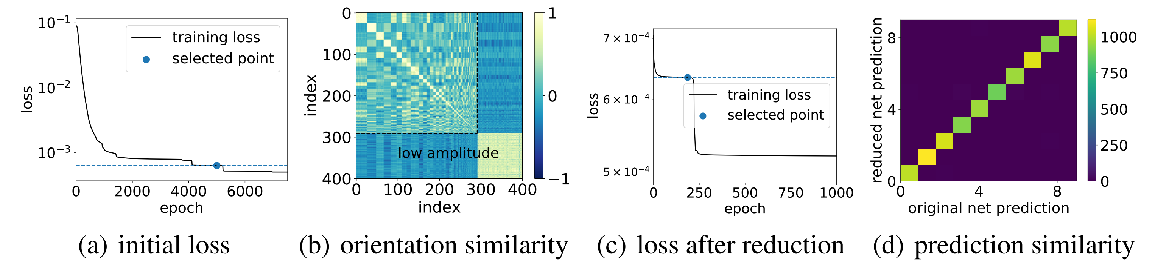
Pruning
MNIST data, 400 hidden neurons→58 hidden neurons.
Zhang*, Li, Zhang, Luo, Xu*, Journal of Machine Learning, 2022, Zhang*, Zhang, Luo, Xu*, NeurIPS (spotlight), 2021

Slide 22
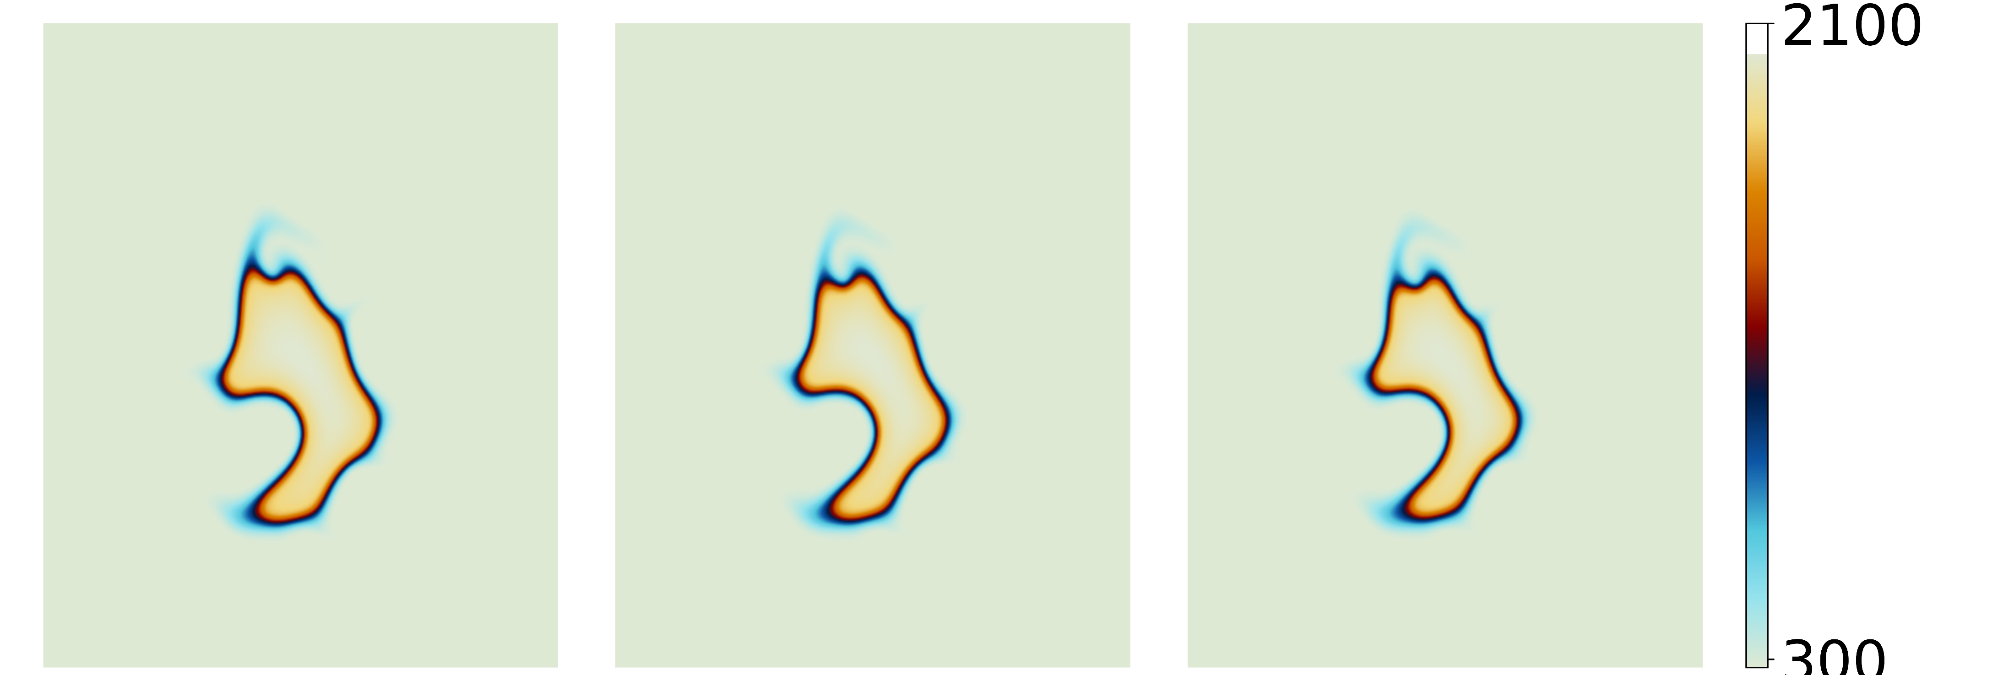
Model Reduction in turbulent ignition simulation
original
3200-1600-800-400
Reduced based on cos>0.999
1055-1309-800-400
Neural network is used to predict chemical reaction rates.

Slide 23
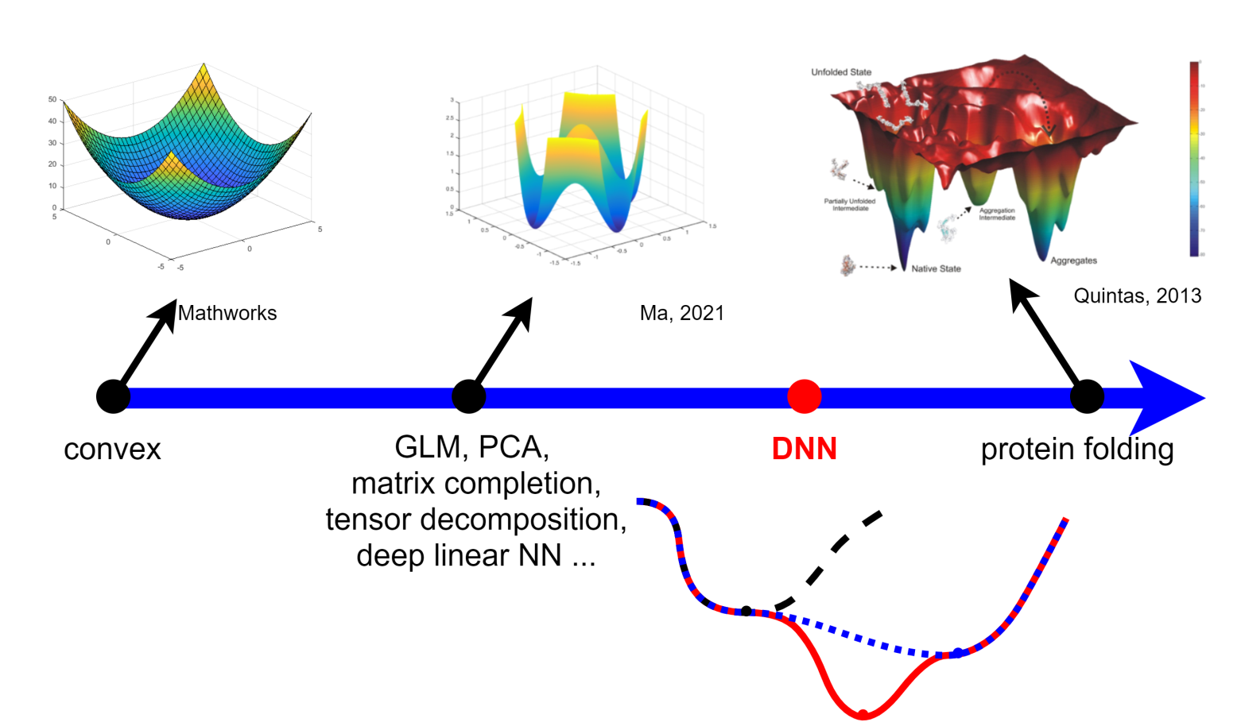
Suggested picture of DNN loss landscape
Zhang*, Li, Zhang, Luo, Xu*, Journal of Machine Learning, 2022, Zhang*, Zhang, Luo, Xu*, NeurIPS (spotlight), 2021

Slide 24
Embedding Principle:
the loss landscape of any network
“contains”
all critical points of all narrower networks.
E-Principle: a basis for condensation,
a path for gradually increasing the # of effective neurons
Occam’s Razor
If no need, no more effective neurons
Small net is effective
Zhang*, Li, Zhang, Luo, Xu*, Journal of Machine Learning, 2022, Zhang*, Zhang, Luo, Xu*, NeurIPS (spotlight), 2021

